Slide 1





A Volunteer Monitoring Program: Illinois River Watershed
Leslie Massey
Arkansas Water Resources Center
UA Division of Agriculture
Funding provided by ANRC through the Illinois River Watershed Partnership

Slide 2
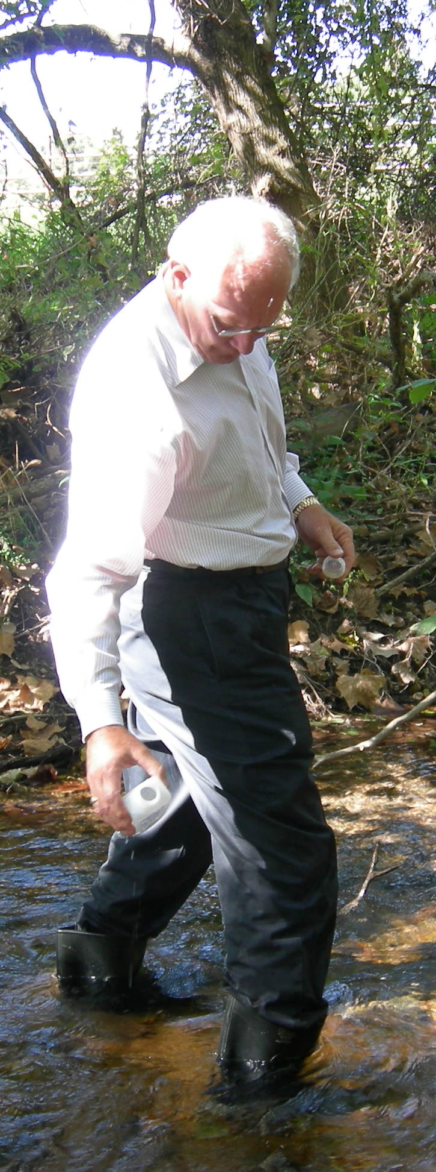
Why use volunteers?
Economical
  Free labor!
  Major project expenses are laboratory analytical costs
  Hach kits can be cheaper but you don’t always get enough information about stream chemistry to be useful
Educational
  VMP are a great way to get stakeholders interested in environmental issues and (hopefully) promote a sense of responsibility to protect and improve water quality

Slide 3
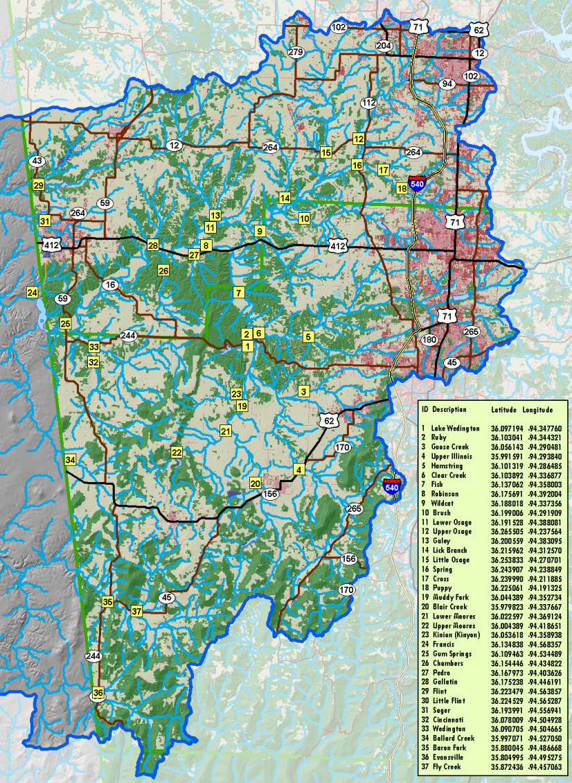
The Illinois River VMP—Site Selection
IRWP used this data to aid in the prioritization of HUCs; so we needed sites that:
  Encompassed the entire watershed
  Varied in catchment land use
  Bracketed known point sources
Replicated a study done in 1993-1994 by Parker et al.
  37 sites
  Located at easy access points
  (walking access or bridges)
  Safety a priority

Slide 4
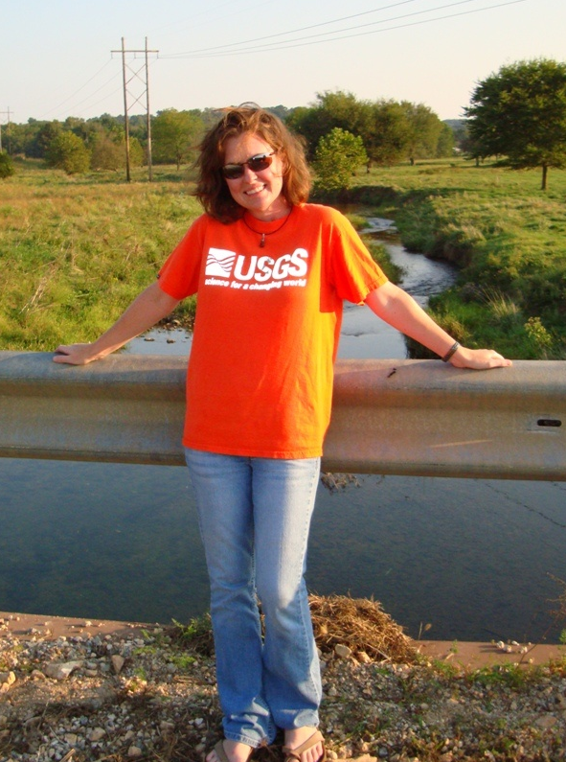

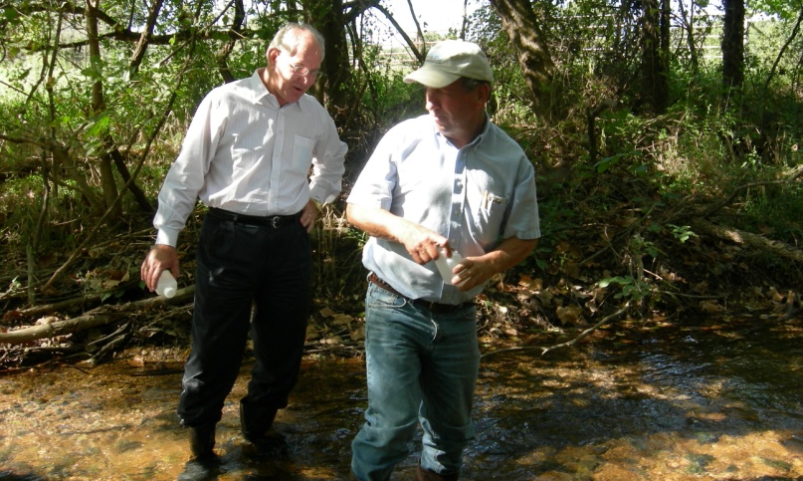
So we had to recruit volunteers…
IRWP took the lead on recruiting volunteers
  Newspaper
  IRWP and AWRC website
  News (Watershed Wednesdays)
  Other partnerships and organizations
We had all sorts of volunteers
  Families
  Businesses (Tyson, Simmons, JB Hunt)
  Schools (TG Smith Elementary, Prairie Grove, Jr. High, AEES)
  Boy scout troops

Slide 5
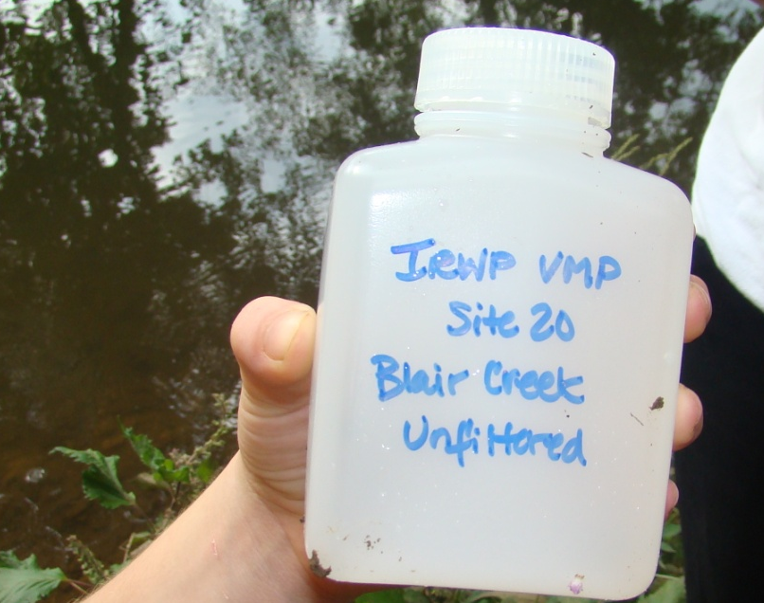
Coordinating sampling required good organization.
Volunteers collected four samples over the course of a year (September, December, March and May) during base flow conditions
We met them at their site in September to make sure they were in the right spot, and to teach them how to properly collect a sample:
  Field rinse bottle three times
  Collect sample from flowing water
  Fill out chain of custody form
  Deliver samples to lab
  Pick up sampling bottles and chain of custody for next time
Sampling tips on chain of custody

Slide 6
Some volunteers were more reliable then others.
Some volunteers were eager and needed no management
Some needed multiple reminders…
  Send out an email a week before the targeted month
  Send reminder emails mid month for sites that hadn’t been sampled
  Made phone calls if necessary…
  Occasionally we sampled for the volunteer last minute
The best volunteers were those who didn’t feel obligated to sign up…

Slide 7
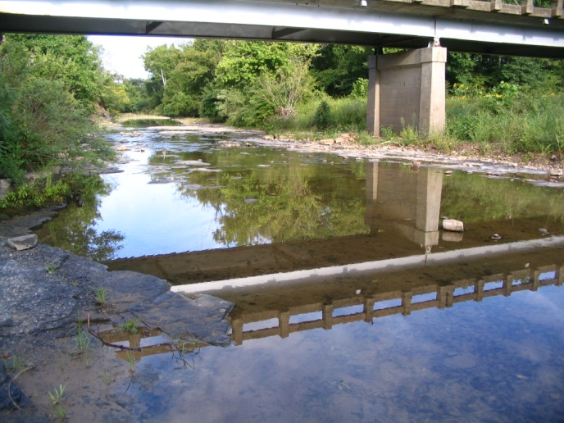
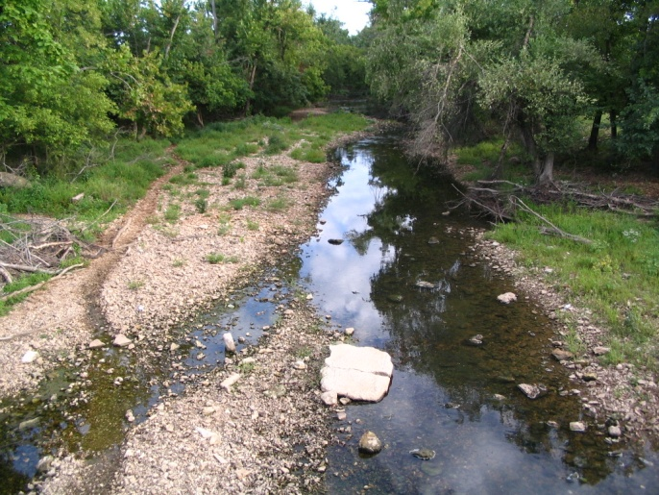
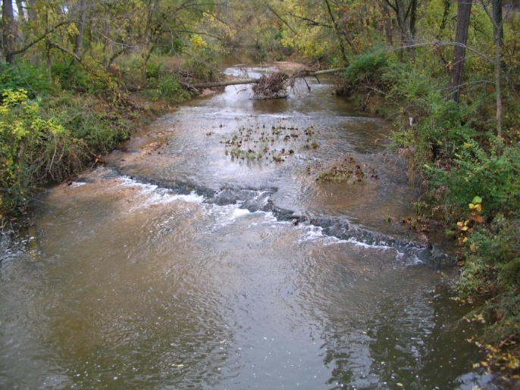
They volunteered because they were interested…
So, we made sure to provide the results to the volunteer
But, most didn’t know what the results meant
  Provided them with the results from their site and then gave the range from all the sampled sites
  Gave an idea if their site was high, low or average

Slide 8
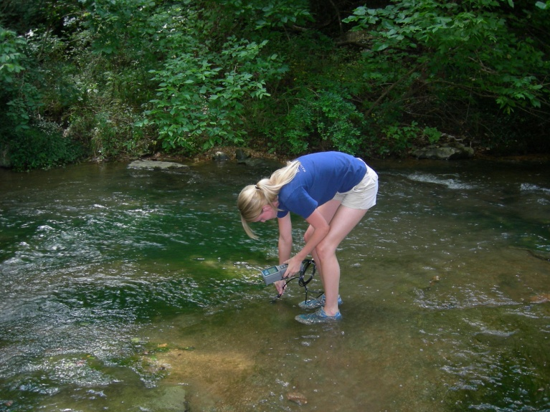
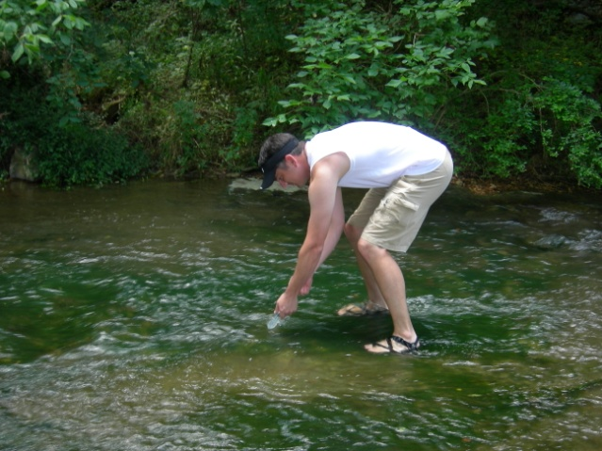
So, was the data collected by volunteers good enough?
Some studies have shown that volunteer data varies significantly from professional data (e.g., Savan et al., 2003)
But, we wanted high quality data that would be acceptable by scientific community
  Developed a QAPP
  Trained volunteers to collect samples following EPA techniques
  Kept it simple! Collecting grab samples and making site notations
  Collected duplicates

Slide 9
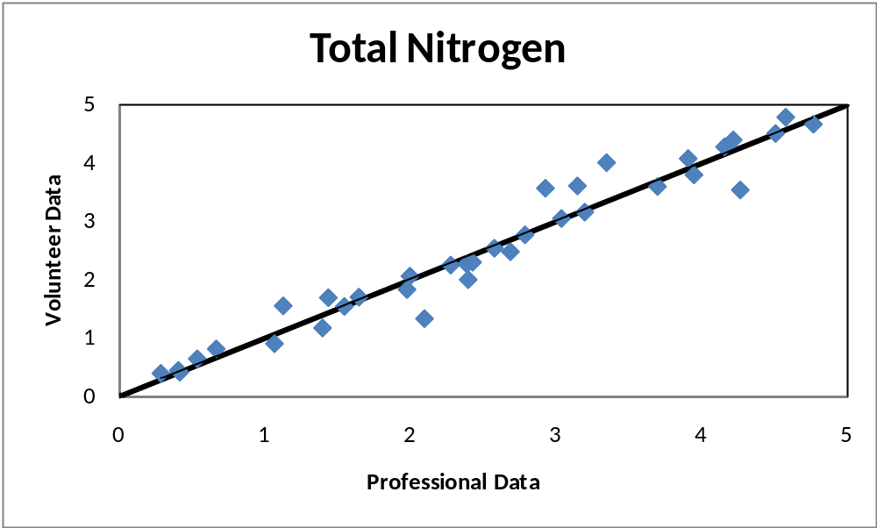
So, was the data collected by volunteers good enough?
Some studies have shown that volunteer data varies significantly from professional data (e.g., Savan et al., 2003)
But, we wanted high quality data that would be acceptable by scientific community
Volunteer data validated by professional data
  Developed a QAPP
  Taught volunteers to collect samples following EPA techniques
  Kept it simple! Collecting grab samples and making site notations

Slide 10
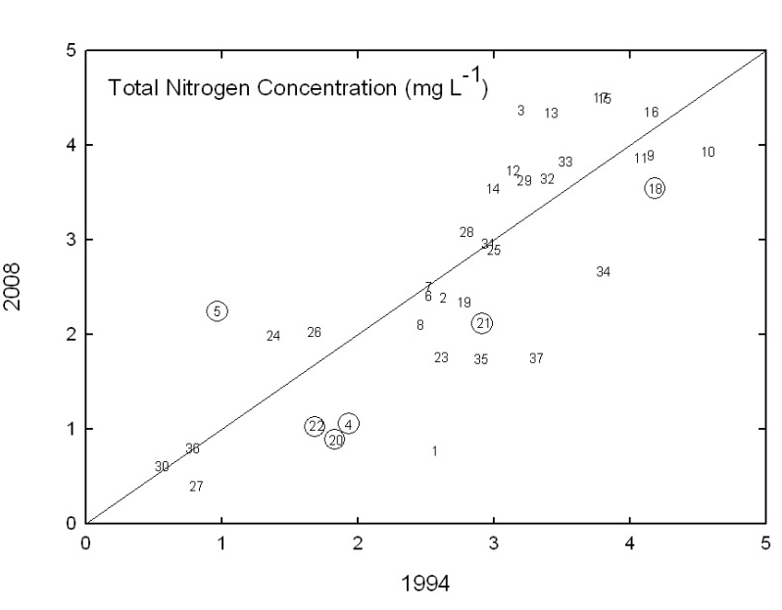
What were we able to do with the data?
Compare with 1993-1994 study

Slide 11
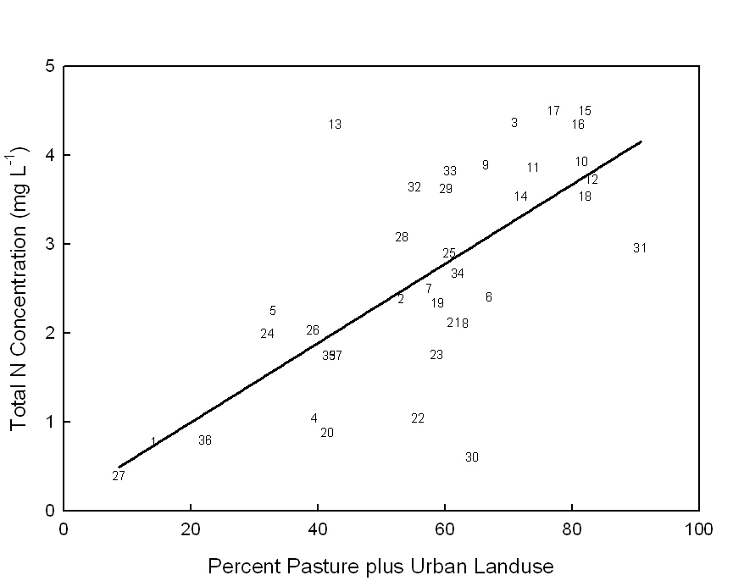
What were we able to do with the data?
Compare with land use…
Positive correlation…
R²= 0.38
P< 0.0001

Slide 12
Lessons Learned…
Some volunteers aren’t always reliable…
  Some volunteers were eager; some needed several reminders
  We had to be ready to run out and grab some samples at the last minute
QC duplicate samples weren’t true duplicates since professional and volunteer didn’t necessarily sample on the same day of the month
  Water chemistry can vary from day to day

Slide 13
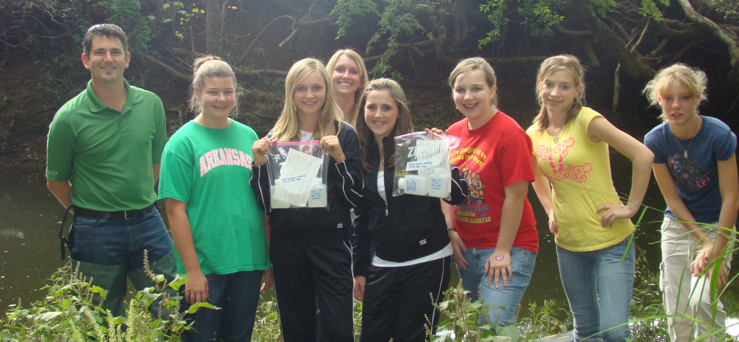
Volunteer Monitoring Continued
The AWRC is considering using 104B funding to support analytical costs of Volunteer Monitoring Programs—contact us if you are interested in getting a program started.

